Slide 1
President’s Palace and Arsenal (Izhevsk)

Slide 2
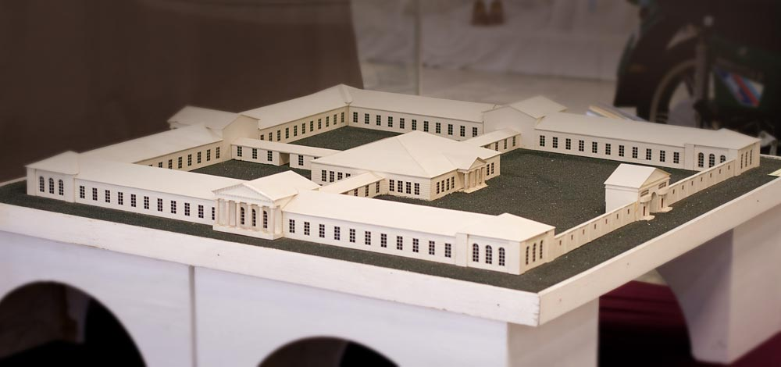
Arsenal

Slide 3
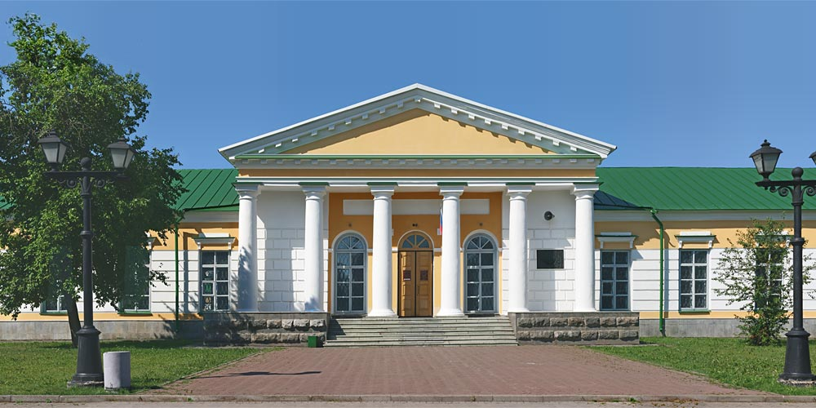
History of Arsenal
1827 – the end of building
1995 – The National Udmurt Museum
2000 – The Museum of Kuzebay Gerd

Slide 4
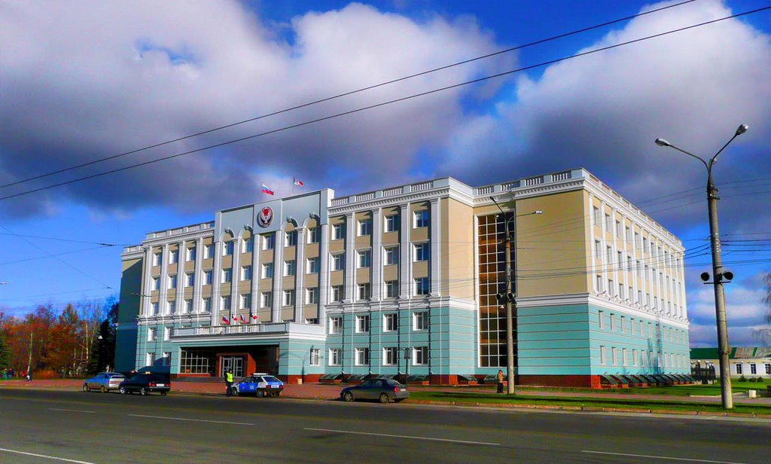
President Palace

Slide 5
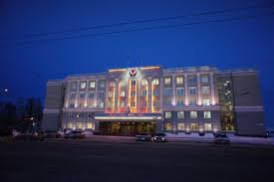
History of President’s Palace
1961-1964 – building
2007 - reconstruction

Slide 6
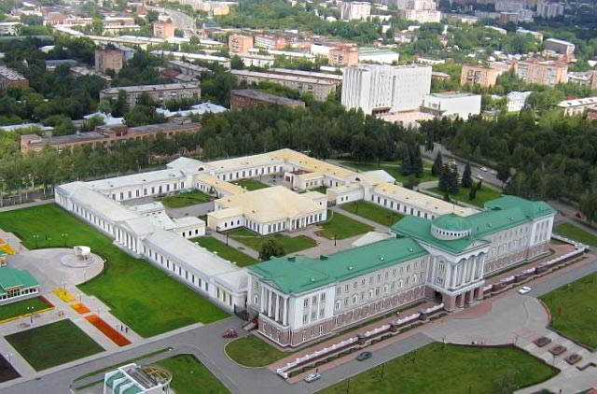

Slide 7
Thank you for attention!!!

